Slide 1





Earth Observation (EO) for Smart Cities:
The SMURBS/ERA-PLANET EU Project and the contribution of EO to the SDGs frame
Dr. Evangelos Gerasopoulos
(Research Director, NOA)
Director of the Greek GEO Office
0

Slide 2






What does Earth Observation refer to?
Satellites
Citizen science
UAVs, smart sensors
In situ
Models

Slide 3




What is a Smart City?
A smart city is an urban area that uses different types of electronic data collection sensors to supply information which is used to manage assets and resources efficiently.
The smart city concept integrates information and communication technology (ICT), and various physical devices connected to the network (the Internet of things or IoT) to optimize the efficiency of city operations and services and connect to citizens.
wikipedia
ICT

Slide 4
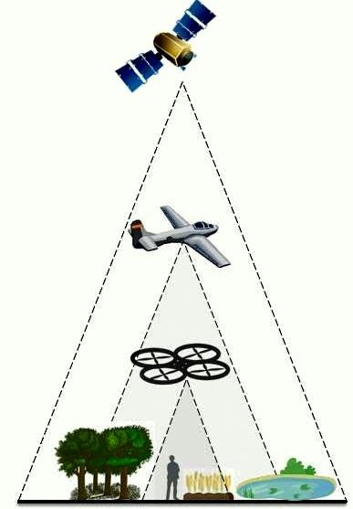

We aim at linking these two huge, distinct yet interconnected worlds, and deliver our own interpretation or definition of smart cities

Slide 5






SMURBS project
Strand 1
“Smart Cities and Resilient Societies”

Slide 6

the fellowship of SMURBS
19 partners, 12 countries
2.75 m€, 9.15 m€ total

Slide 7
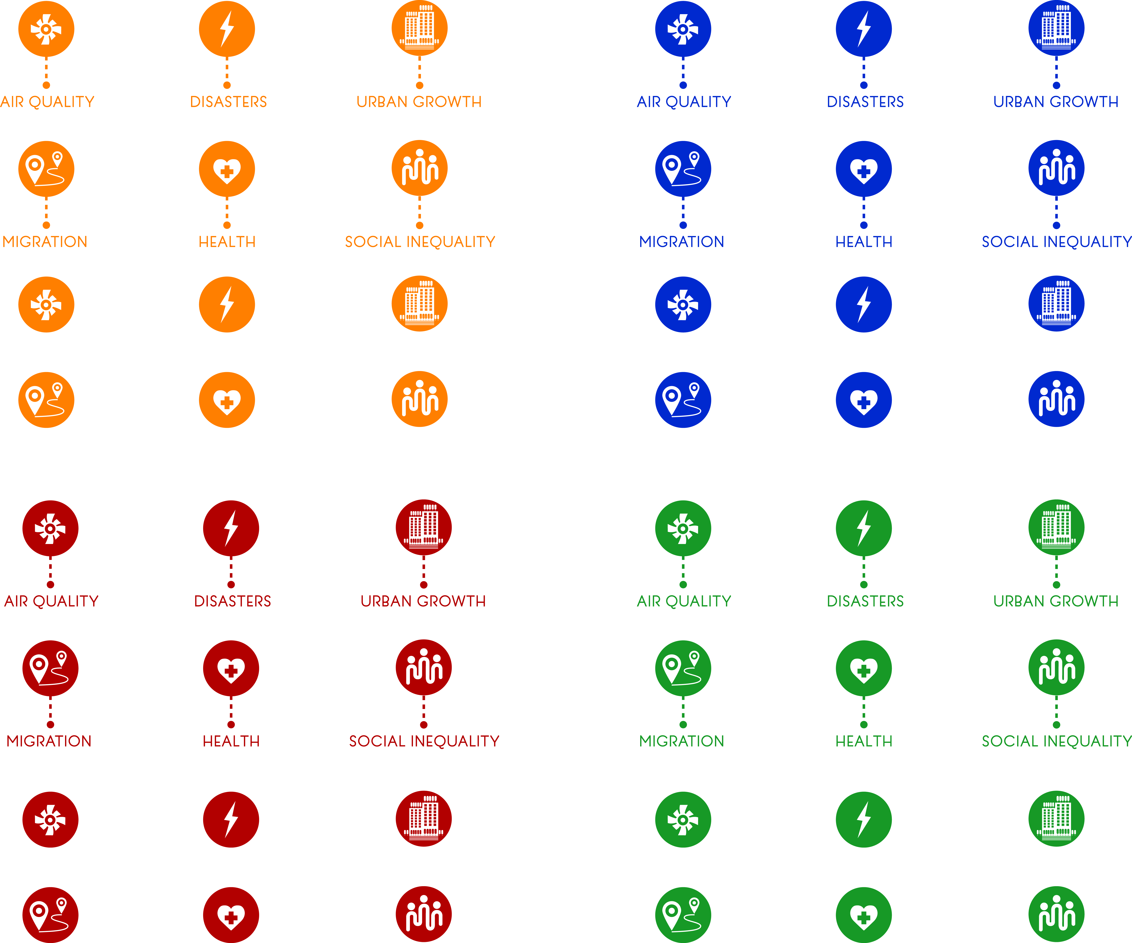
Our themes

Slide 8

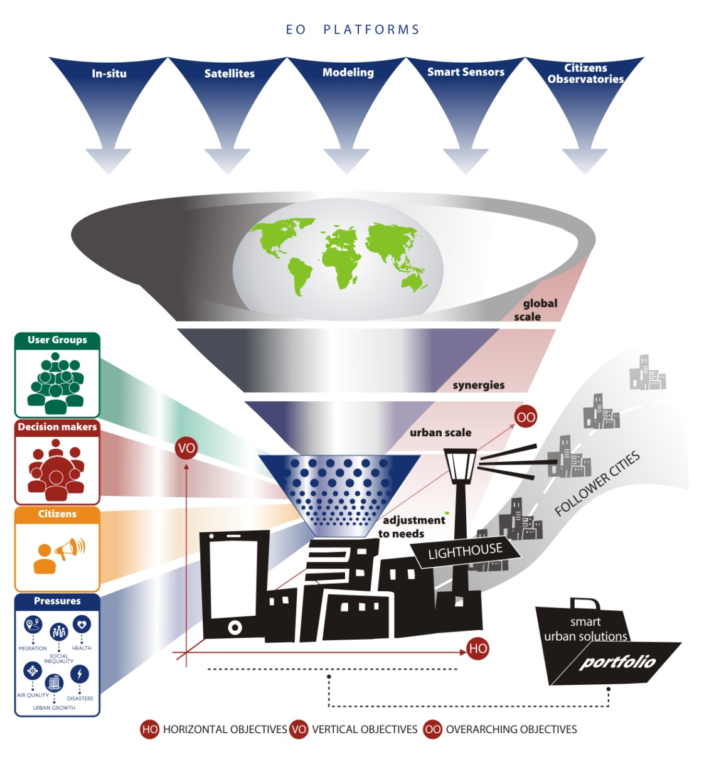
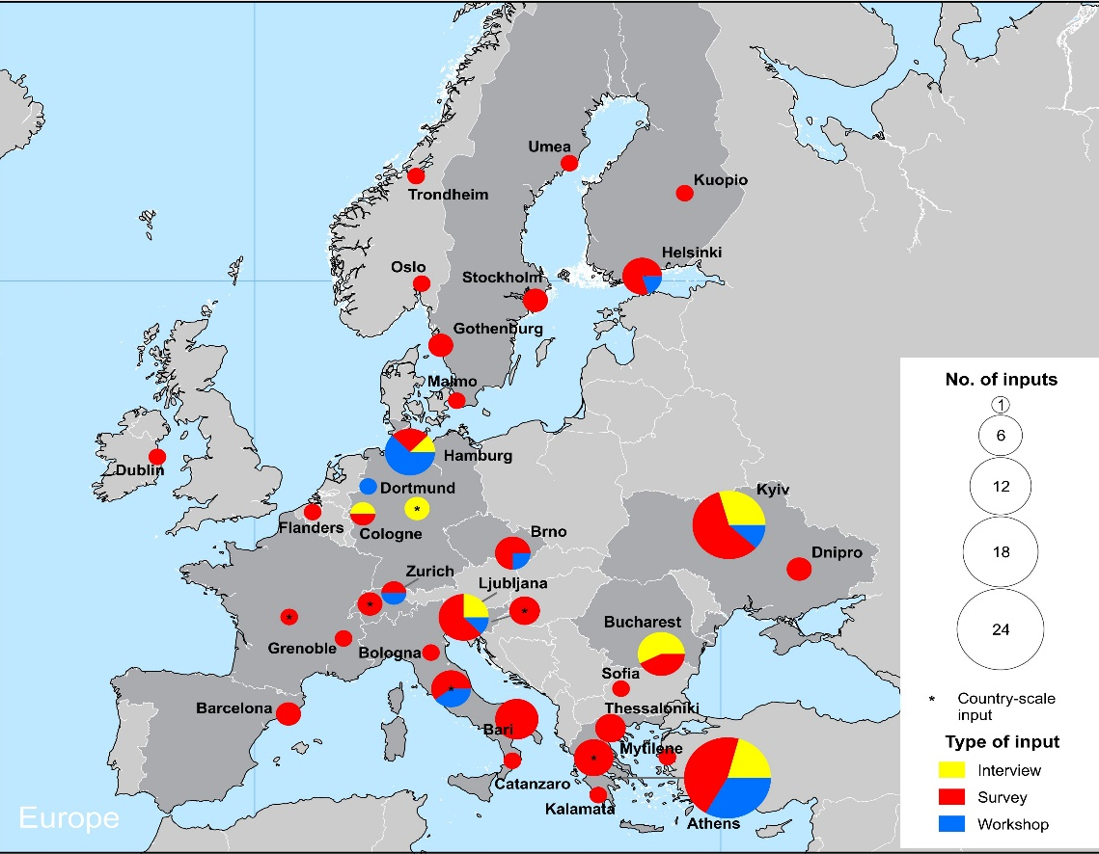
the concept
develop synergies between EO platforms
converge under the “smart city” banner
take user needs on board
tailor solutions to the thematic areas
deliver a portfolio of smart urban solutions
test and showcase in pilots
let the followers amplify the impact
Up to now:
129 stakeholders
from 32 cities,
18 countries
More info at: http://smurbs.eu/

Slide 9
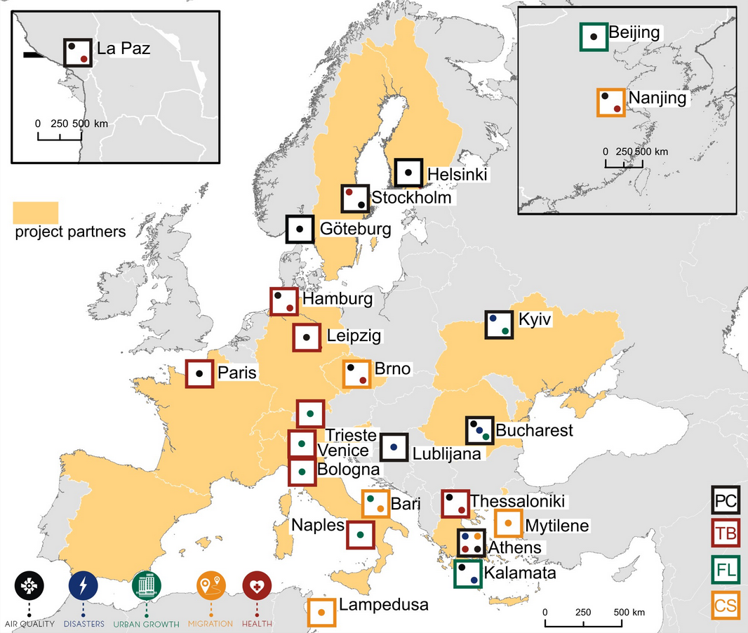
the network
Partnership:
The SMURBS consortium consists of 19 ERA‐PLANET partners from 12 European countries, including research institutes, space agencies and universities, EO experts of different disciplines and scientific background, in several thematic areas.
More info at: http://smurbs.eu/
Smart-city network:
A group of 23 cities (3 overseas) of varying sizes, geographies, environmental pressures and levels of progress in terms of ‘smartness’ are selected with a multi-criteria analysis, to employ solutions from the portfolio and help establish the urban component of GEOSS in Europe.

Slide 10
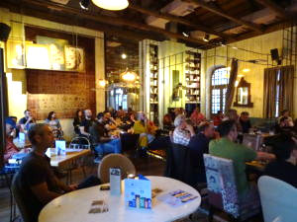
… act local
SMURBS organized its 1st citizen workshop hosted by Navarino Environmental Observatory in the city of Kalamata, during April’s scientific café. More than 40 citizens participated in the event, sharing their needs and smart ideas, over a hot cup of coffee!
The discussion reaffirmed many of the user needs findings, especially with respect to Air Quality requirement for real time, online information and the potential role of citizen observatory activities, along this direction, where highlighted with great zest.

Slide 11



GEO main priority
and SMURBS objective

Slide 12
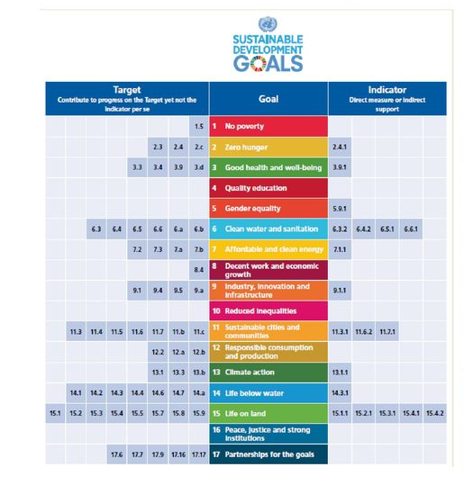







talking GLOBAL

Slide 13



talking EUROPEAN

Slide 14

talking GREEK

Slide 15
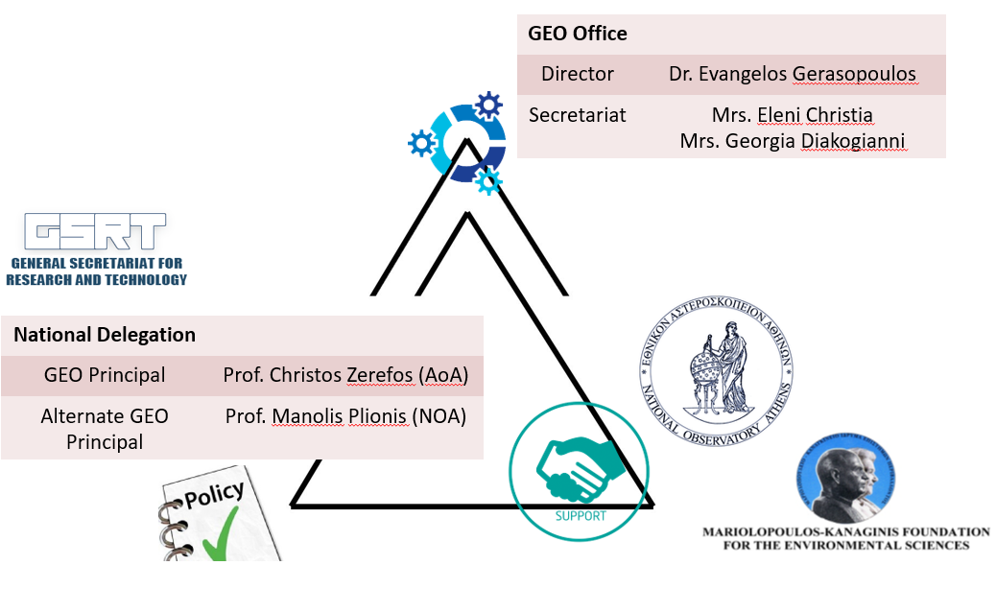
Mandate The Greek GEO Office (GGO) operation focuses on the effective participation of Greece in the national, regional, and global activities, under the framework of GEO and GEOSS … as the focal point of GEO activities in Greece, it addresses the need for a permanent coordination mechanism of GEOSS activities at the national level, at the same time building interfaces with GEO and the Greek State

Slide 16

How can we do
this in practice

Slide 17
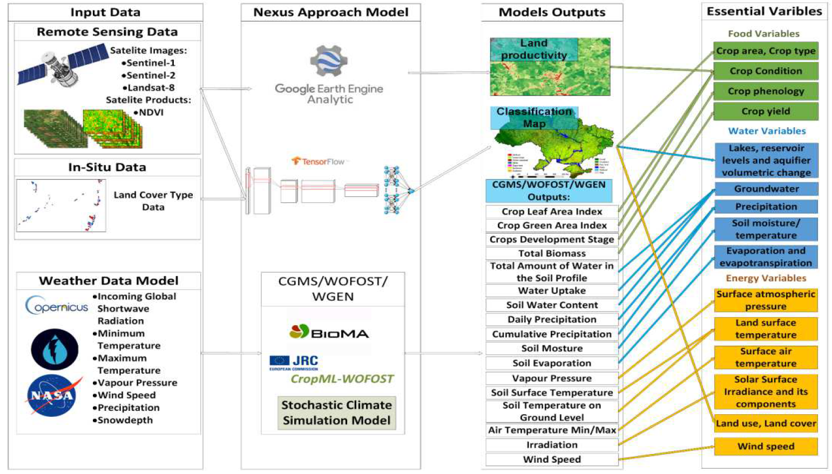
Create data flowcharts

Slide 18
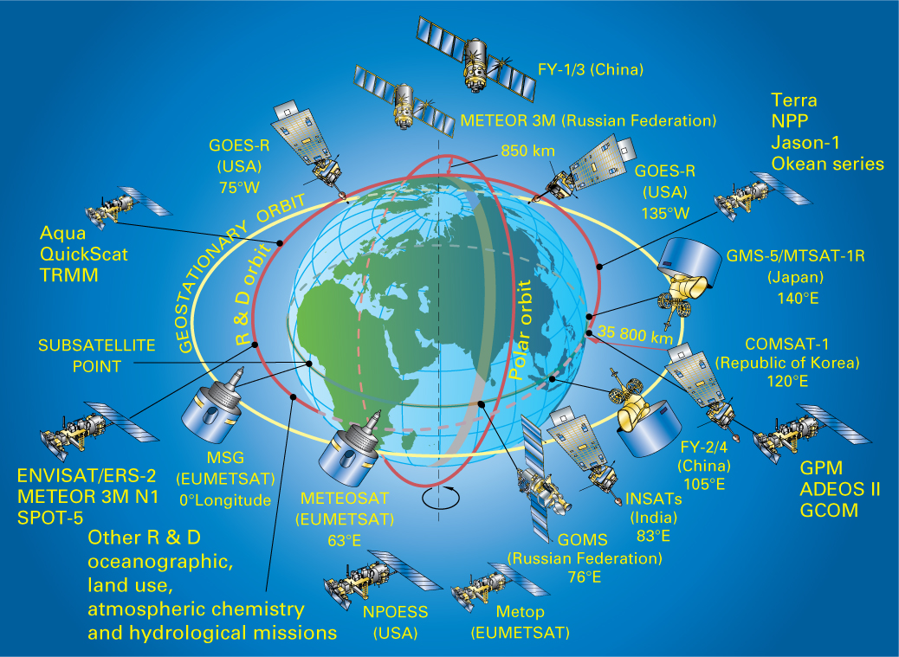

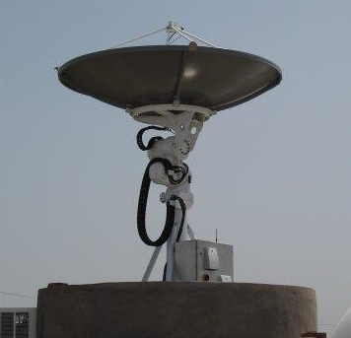
Urban indicators that depend on EO data
  11.1.1 Proportion of urban population living in slums, informal settlements or inadequate housing
  11.2.1 Proportion of population that has convenient access to public transport, by sex, age and persons with disabilities
  11.3.1 Ratio of land consumption rate to population growth rate
  11.6.2 Annual mean levels of fine particulate matter (e.g. PM2.5 and PM10) in cities
  11.7.1 Average share of the built-up area of cities that is open space for public use for all, by sex, age and persons with disabilities
Urban Essential Variables

Slide 19


Example – SDG 11.3.1
Ratio of land consumption rate to population growth rate (SDG Indicator 11.3.1):
City population
Built-up area
Stage 1: Estimate the population growth rate.
PGR=LN(Popt_(t+n)/Popt_t )/((y))
Where
Popt: Total population within the city in the past/initial year
Popt+n: Total population within the city in the current/final year
y: The number of years between the two measurement periods
Stage 2: Estimate the land consumption rate.
LCR=LN(Urb_(t+n)/Urb_t )/((y))
Where
Urb_t: Total areal extent of the urban agglomeration in km2 for past/initial year
Urb_(t+n): Total areal extent of the urban agglomeration in km2 for current year
y: The number of years between the two measurement periods
From Prof. Petros Patias, EuroGEOSS Workshop 2018

Slide 20
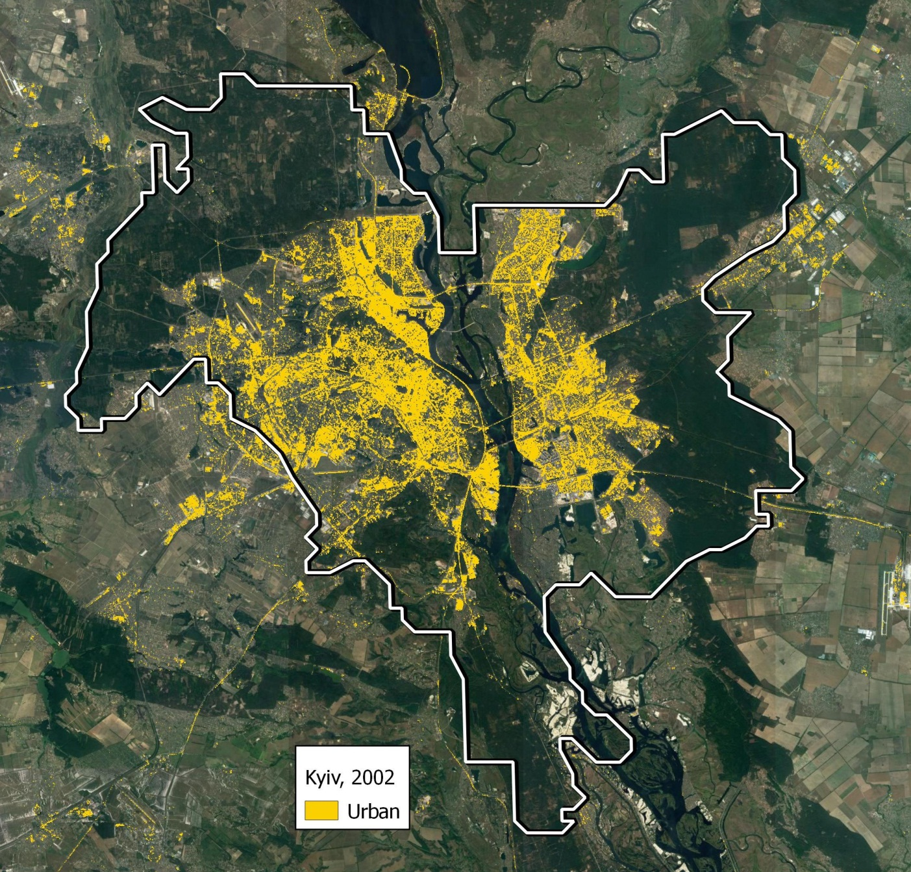
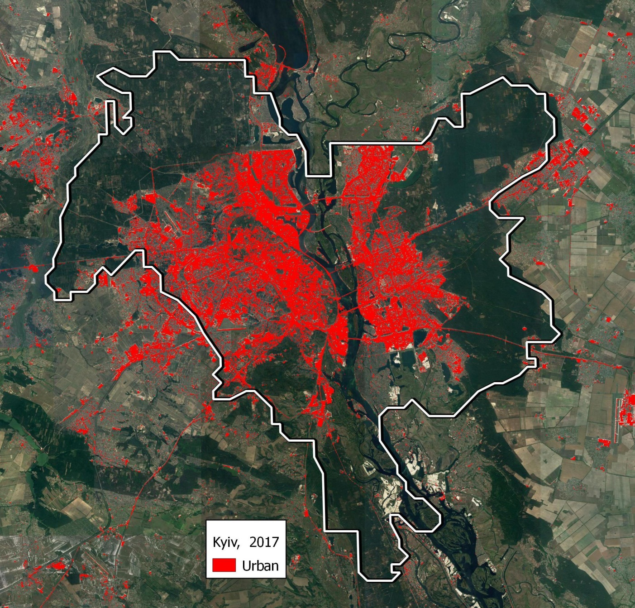
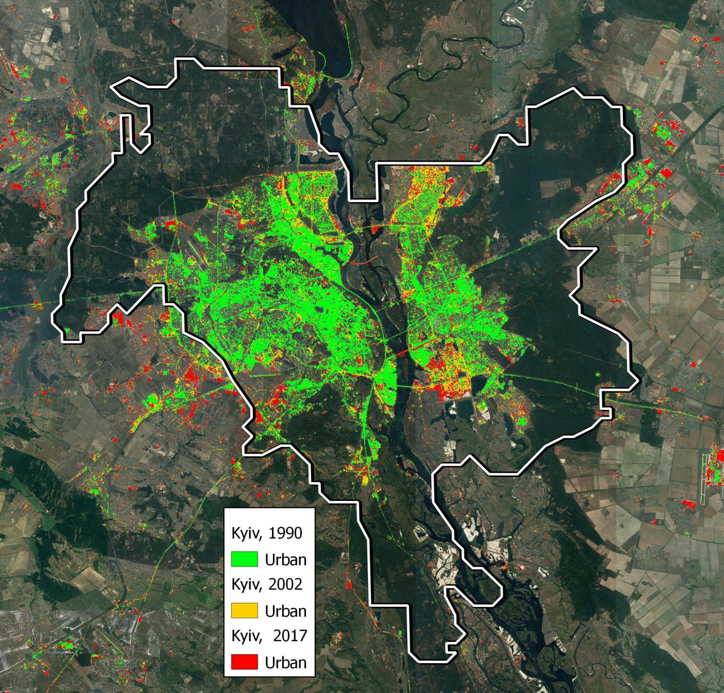
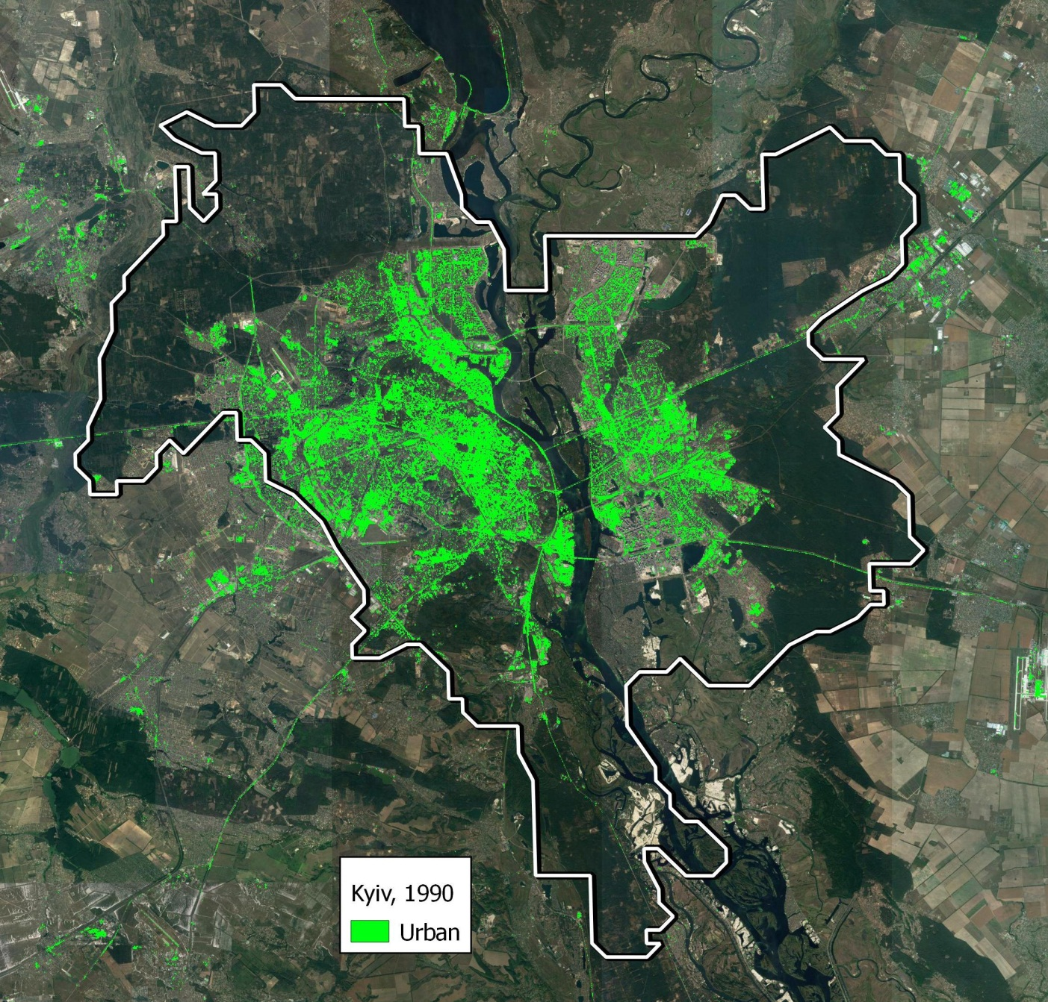
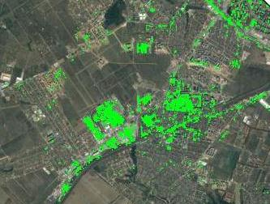
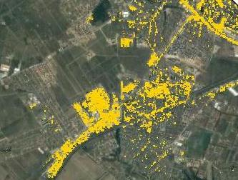
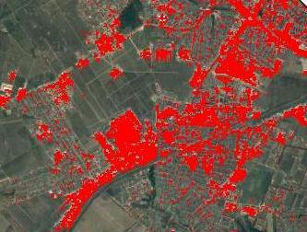
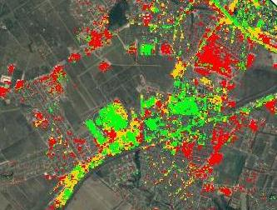
Kiev city growth 1990-2017
From Dr. Natalia Kussul (SRI),
SMURBS stakeholders workshop, Hamburg
Vishneve becomes
a part of city

Slide 21
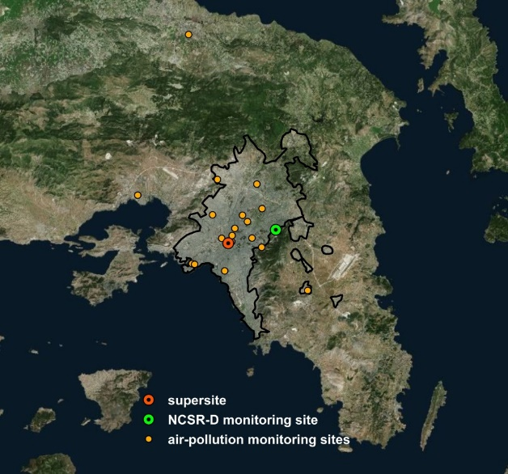
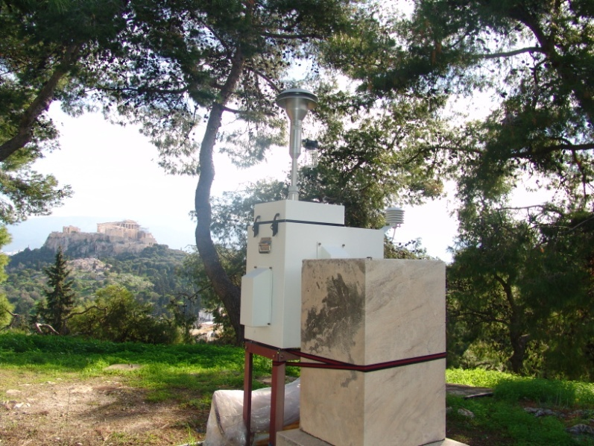
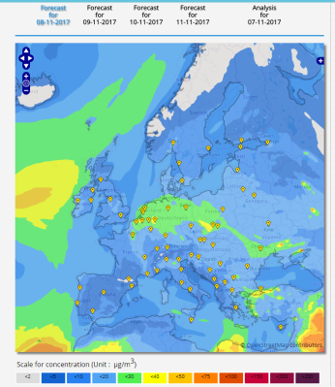
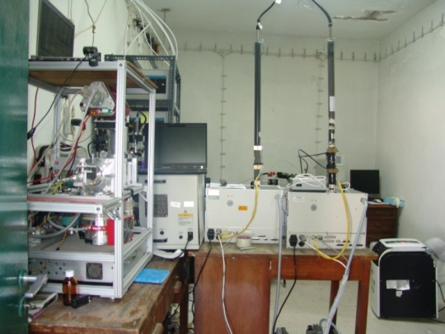
Urban indicators that depend on EO data
  11.1.1 Proportion of urban population living in slums, informal settlements or inadequate housing
  11.2.1 Proportion of population that has convenient access to public transport, by sex, age and persons with disabilities
  11.3.1 Ratio of land consumption rate to population growth rate
  11.6.2 Annual mean levels of fine particulate matter (e.g. PM2.5 and PM10) in cities
  11.7.1 Average share of the built-up area of cities that is open space for public use for all, by sex, age and persons with disabilities
Urban Essential Variables

Slide 22
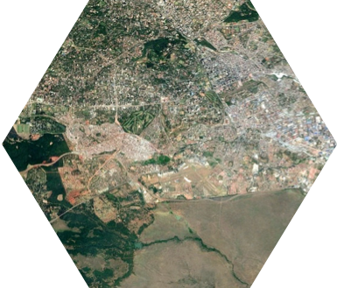
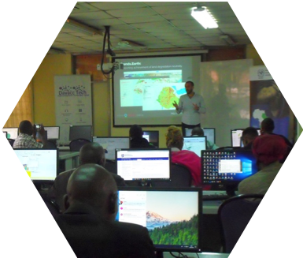




Land consumption refers to the conversion of open space or farmland to residential, commercial, or other developed land uses, including over-intensive exploitation of land.
Trends.Earth
A platform for global spatial analysis and assessments of SDGs
Trends.Earth brings together models developed with support from the GEF and NASA that leverages Google’s Earth Engine platform to integrate earth observation data from multiple sources at user-defined scales and timeframes. The project increases access to earth observation data to improve assessment and reporting for the SDGs.
SDG 11.3: By 2030 enhance inclusive and sustainable urbanization and capacities for participatory, integrated and sustainable human settlement planning and management in all countries
Team:
Conservation International: Alex Zvoleff, Mariano Gonzalez-Roglich, Monica Noon
NASA: Lahouari Bounoua, Eric Brown De Colstoun, Stephanie Uz
http://trends.earth
Supported by
funding from NASA and the Global Environment Facility (GEF) with capacity building and tool development lead by Conservation International

Slide 23


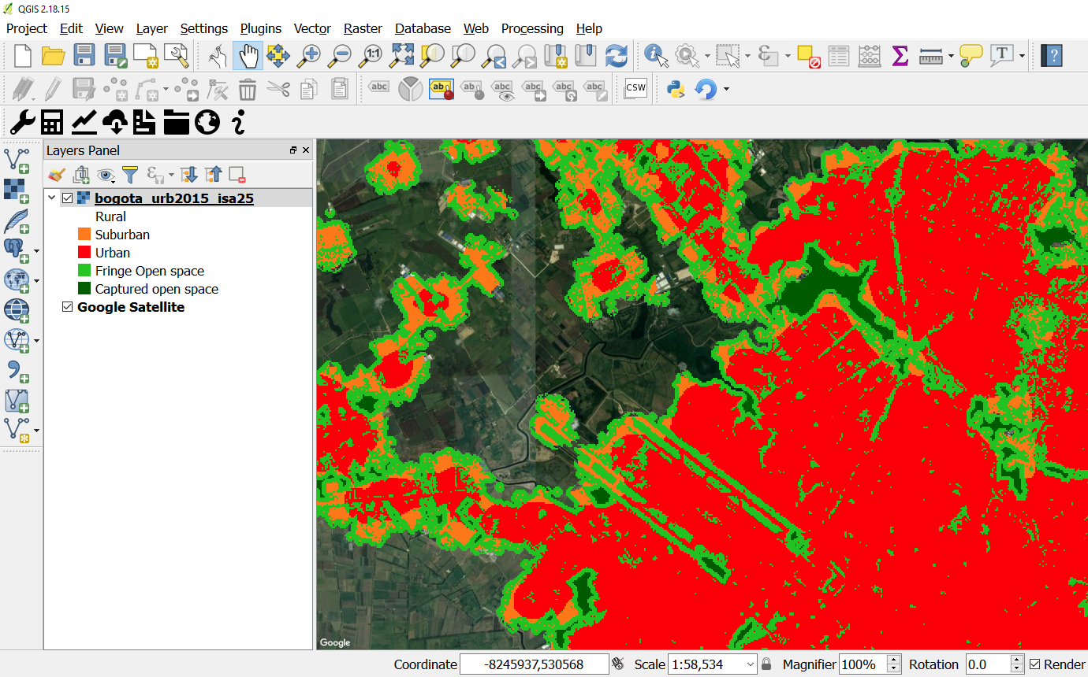
Development of tool to asses the ratio of land consumption rate to population growth rate
PI: Alex Zvoleff, Conservation International
Background:
Promotes user driven assessments -- Trends.Earth provides high-resolution spatial and temporal datasets for measuring land consumption rates in urban areas validated in 10 countries.
Trends.Earth uses remotely sensed imagery to measure urban extent to map change over time and overlays gridded population to asses the land consumption rate. The tool is easy and free to use.
Impact:
Trends.Earth has over 1,000 registered users globally; trainings have been held in nine different countries representing over 300 participants from 146 countries.
.
Figure 1. The output from the Trends.Earth tool reporting on Sustainable Development Goal (SDG) 11.3.1: Land consumption in Bogota, Colombia with Sub-urban (orange), Urban (red), Fringe open space (green), Captured open space (dark green) classes calculated using remotely sensed data.

Slide 24

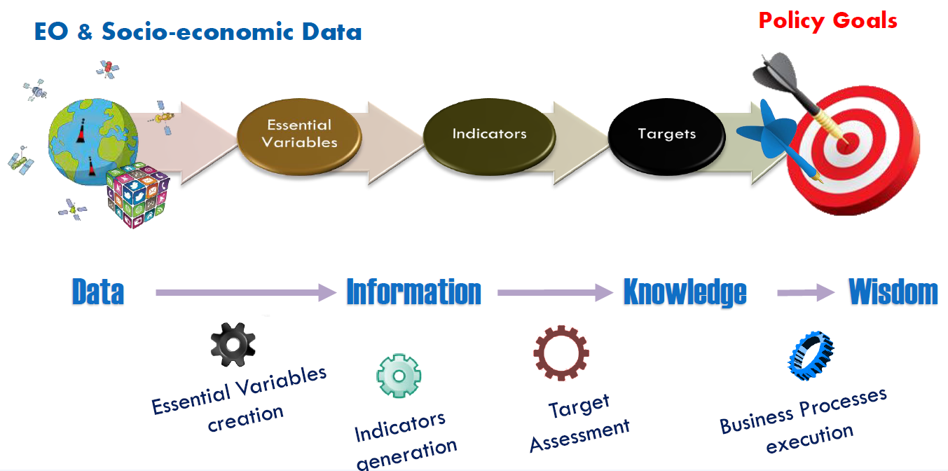
From EO to knowledge

Slide 25

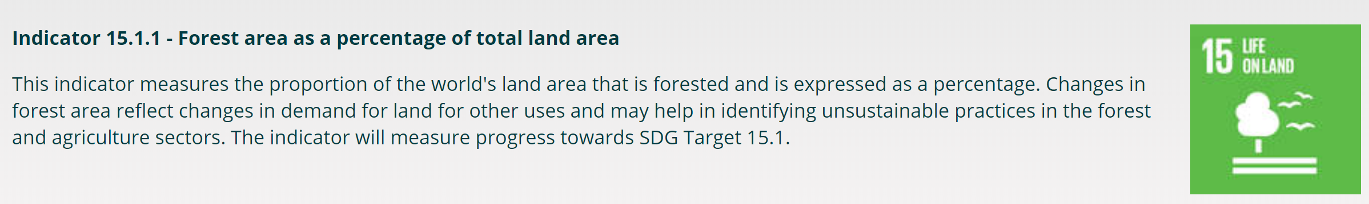
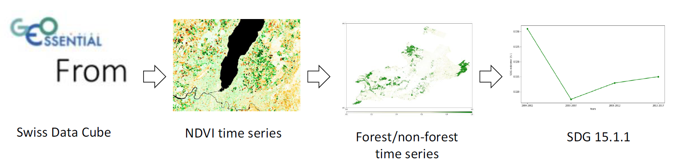

it is happening nationally …
From Swiss GEO Office, EuroGEOSS 2018 Workshop
An established interaction in Germany
The BKG (Federal Agency of Cartography and Geodesy ) has been working trustfully together with e.g. the Federal Statistical Office to implement national and international measures relating to the sustainability goals of UN.
The Presidents of the BKG and Destatis formalized this cooperation with a Memorandum of Understanding (MoU) in November 2016. It is part of the MoU to create an action plan that is annually updated and contains concrete cooperation plans.
BEST PRACTICE ?

Slide 26
Take home!
EO and SDG domains only marginally overlap
10-15% of SDG indicators can “be obtained or supplemented by EO procedures”. Social and economic statistic data prevail

Slide 27
Take home!
UN-GGIM (United Nations Committee of Experts on Global Geospatial Information Management (UN-GGIM)) says: “As the implementation of the 2030 Agenda gains momentum, Member States and the global community are now also beginning to understand the commensurate prospects for using Earth observations and geospatial information as fundamental inputs for realizing the 2030 Agenda.”
All parties agree that EO has the potential to support national reporting and make SDG monitoring truly sustainable.

Slide 28
Take home!
The Global indicator framework adopted by the General Assembly also states that " Sustainable Development Goal indicators should be disaggregated, where relevant, by income, sex, age, race, ethnicity, migratory status, disability and geographic location, or other characteristics, in accordance with the Fundamental Principles of Official Statistics.“
EO is not only for monitoring but also supporting indirectly the SDGs e.g. providing geospatial data that can help disaggregate other statistics data and make them really SMART

Slide 29
Take home!
All parties agree that National Statistical Offices (NSO) and indicators’ Custodian Agencies are key players in the actual integration of EO in the SDG chain

Slide 30


Earth
Observations
0

